Slide 1
Chapter 5
Stack

Slide 2
Stack
Stack
Stacks are data structures that have restricted data access, which can be accessed from end or start of the list.

Slide 3
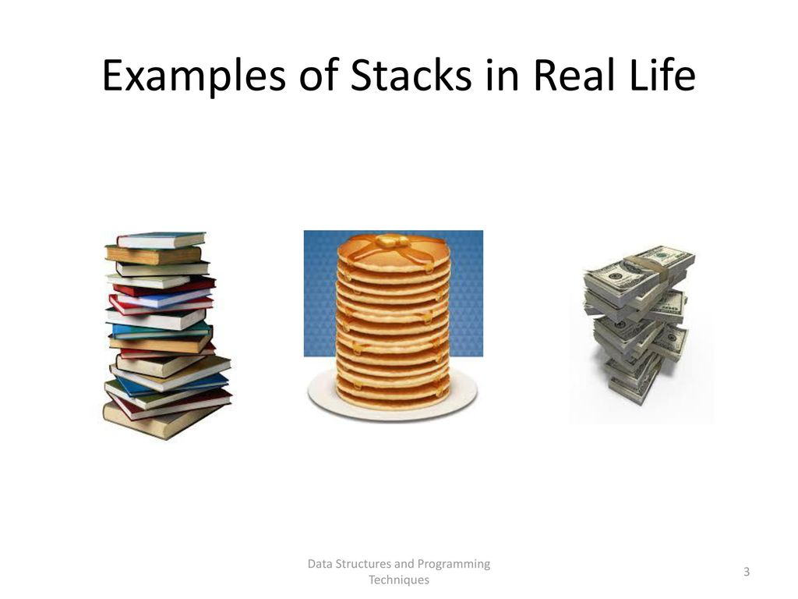



Stack
It is a data structure that has access to its data only at the end or top of the list.
It operates on LIFO (last in first out) basis.
Stack uses a single pointer or (index) to keep track of the information or data on the stack.
It has two basic operations:
Push: inserting or adding data at the top of the stack,
Pop: removing data from the top of the stack.

Slide 4
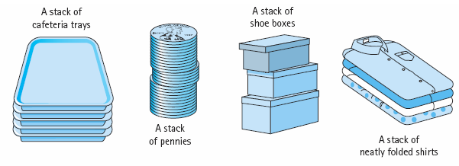
…
A stack of coins

Slide 5
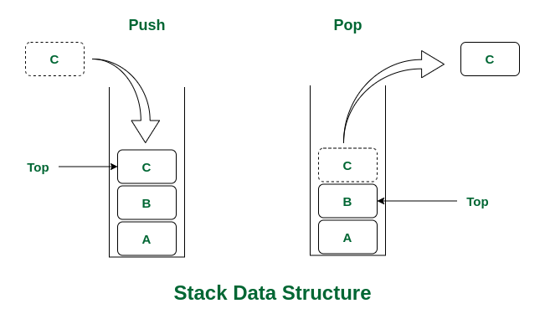
…

Slide 6
…
Push Pop
9
6
5
Push(5)
Push (6)
Push (9)
Pop
Push(7)
Push(12)
Push(15)
pop
15
12
7
6
5
………………..
……………….
12
7
6
5

Slide 7
Array implementation of push and pop operation
Analysis:
suppose the stack has the following structure.
int num[max-size];
We need to have an integer variable that stores an index value that tells us:
The position where to store a new value
The total number of elements stored in the stack
int top =-1;

Slide 8
To push/add an element to the stack
Check if there is enough space in the stack
To add new value we should have to check the space left
top<max_size-1?
Yes – increment top , store the element in num[top]
No – stack overflow

Slide 9
To pop or remove an element from the stack
check if there is data in the stack
top>=0?
Yes: - copy/remove data at num[top], decrement top
No: - stack underflow

Slide 10
Implementation – push
int num[max_size];
int top=-1;
void push(int x)
{
if (top<max_size-1)
{
top++;
num[top]=x;
}
else
cout<<“stack overflow”;
}

Slide 11
Implementation - pop
int pop()
{
int x;
if(top>=0)
{
x=num[top];
top --;
}
else
Cout<<“stack underflow”’;
return x;
}

Slide 12
Implementation
Size of stack
int sizeofstack()
{
return(top+1)
}
Is empty?
Bool isempty()
{
return (top==-1)
}
Is full?
Bool isFull()
{
Return(top==max_size – 1)
}

Slide 13
Linked List Implementation of Push and Pop operations
When we implement stack using array :
We create an array of predefined size & we cannot increase the size of the array if we have more elements to insert.
If we create a very large array, we will be wasting a lot of memory space.
So to solve this lets try to implement Stack using Linked list where we will dynamically increase the size of the stack as per the requirement.
Taking this as the basic structure of our Node:
struct number
{
int num;
number *next;
};

Slide 14
Linked List Implementation of Push and Pop operations
Definition
struct number
{
int num;
number *next;
};
Botptr
Topptr

Slide 15
Analysis:
We need two pointers (Botptr and topptr) that points to first and last node of the stack
number *botptr=NULL, *topptr=NULL;
To push data to the stack
Check if there is enough space in the stack – i.e free memory space. We need a pointer that points to the newly created -
newnumptr = new number;
newnumptr !=NULL→ there is free Memory space pointed by newnumptr
Yes: - copy/store the pushed value to newly created node
Create the link between the last node and the new node….
void push(int value)
{
number*ptr = new number();
ptr->data = value;
ptr->next = top;
top = ptr;
}
Inserting first

Slide 16
(Continued)…
Make topptr to point to the last node (newly created node) → cin>>newnumptr->num; newnumptr->next=NULL;
NO: stack overflow
Botptr
newnumptr
Topptr

Slide 17
POP
Check if there is data in the stack
bottomptr!=NULL???
Yes: - topptr should point to the previous node. When we have only one node botptr and topptr should point to NULL
Deleting the last node
No: - stack underflow
prevptr
botptr
lastptr

Slide 18
Exercise
Write the complete code of stack implementation using single linked list and array.

Slide 19
Application of Stack
1. Variable declaration
Void main()
{int i, n;
for (i=0;i<=10;i++)
{int m;
cin>>n;
cin>>m;
cout<<m*n;
}
cout<<n;
}
m
n
i
Used to hold variables when declared

Slide 20
Application of Stack
2. function calling
Void main(){
Func1();
Func2();
}
Void func1(){
Cout<<“selam”;
Func3();
}
Void func2()
{
Cout<<“Hi”;
}
Void func3(){
Cout<<“Hello”;
}
}
Note : The one that is found on the top of the stack is currently executed. When empty stack remain, the program will halt
Func3()
Func1()
Main()
Main()
Func1()
Main()
1
2
3
4
Func1()
Main()
Func2()
Main()
Main()
5
6
7

Slide 21
Application of Stack
3. recursive programming
int factorial (int n)
{
if(n==0 || n==1)
return (1);
else
return(factorial(n-1)*n)
}
Factorial(0) = 1
Factorial(1) = 1
Factorial(2)= 2
.
.
.
Factorial(n-2)
Factorial(n-1)
Factorial(n)

Slide 22
Application of Stack
Infix to postfix conversion
Infix Notation Postfix Notation prefix Notation
A+B AB+ +AB
Eg.
(A+B)*C AB+C* *+ABC
(A+B)*(C-D) AB+CD-* *(A+B)(C-D)
*+AB-CD
*+-EF,
E=AB, F=CD

Slide 23
Application of Stack
5. Computing Postfix Notation
AB+
+
B
A
Op=pop()
Result
Op1=pop()
Op2=pop()
Op2 op op1 = result
Push (result)

Slide 24
…
example
AB+C*
+
B
A
Result1
*
C
Result1
Result2
+
5
4
*
2
9
18
Eg. 4 5 +2*

Slide 25
…
???
End!!!!!!!!

